Slide 1
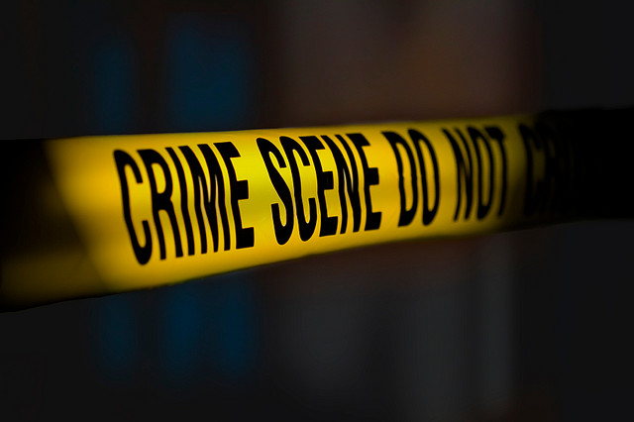
Solving Crimes with Chemistry:
The Case of the Missing Balances

Slide 2
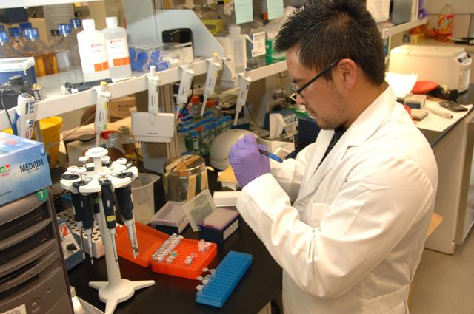
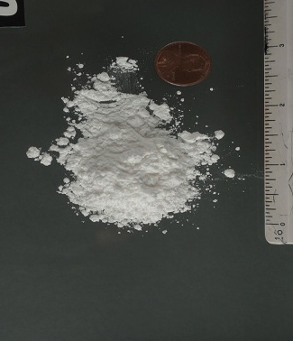
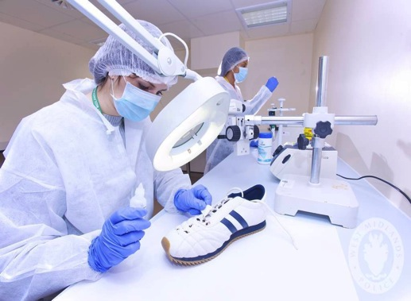
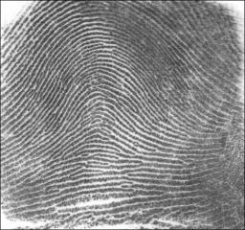
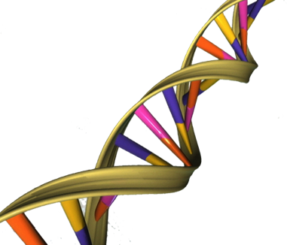
Forensic Science
The scientific method of gathering and examining information used in a court of law.
Notes:
Discuss DNA analysis, fingerprint analysis, analysis of trace evidence (on the shoe or the powder). Could also mention blood splatter analysis and ballistics being physics. People doing forensics need to be good scientists because their conclusions about the evidence have to stand in a court of law, and are being used to convict people. So, today, you all are going to practice doing forensic science!

Slide 3
Case #WHS-329
On November 12, 2014, a group of 100 WHS students were given the opportunity to tour Driscoll’s top security clearance laboratory on Stillman Rd. The students were supervised by nine (9) WHS teachers and the tour was led by Driscoll’s lead scientist, Dr. Feinstein. The students returned to WHS that afternoon. However, the secretary for Driscoll’s called WHS on November 13th very angry about 12 missing digital balances. Because only the teachers were allowed to bring bags or backpacks on the tour, they are the main suspects, along with Dr. Feinstein himself. After police inspection of the laboratory, a note was found reading “I’m not a bad person, I’m just a public school teacher.” Police are not ruling out Dr. Feinstein as having written the note to frame a teacher. A small amount of white powder was also found at the scene, and Driscoll employees (who keep the lab spotless) insist that it was left by the thief.
Notes:
To do forensic science, we need a crime. Can someone volunteer to read the description of the crime? While he/she reads the description start to think about evidence (clues) and facts about the crime.
Once reading is over, ask students to identify the two pieces of evidence. (Answer: the note and the white powder)

Slide 4
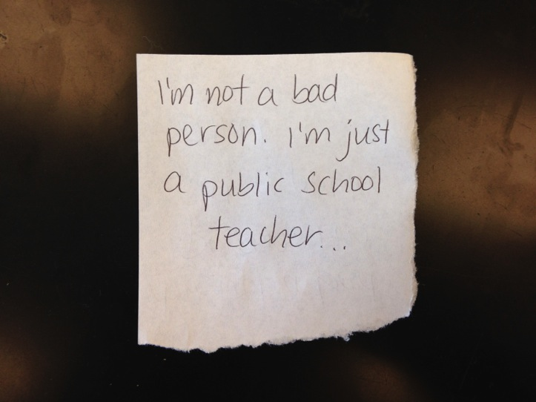
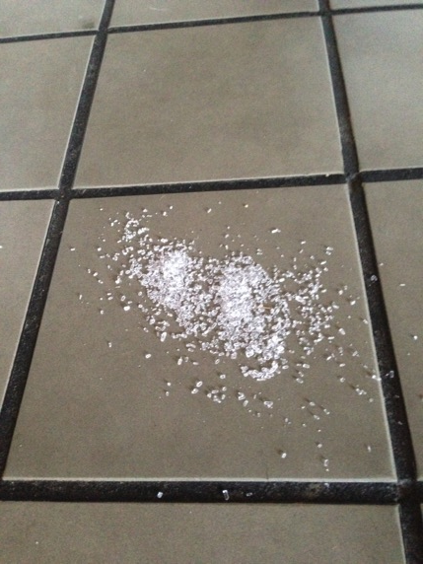
The evidence
Evidence-329
Exhibit A
Evidence-329
Exhibit B
Notes:
Who has ideas about how you could test and identify this evidence? Keep in mind that we’re in chemistry class, so you’ll probably be skills that we’ve learned in chemistry. (Have a quick discussion about what tests you might do, what those tests might tell you, and how that information could lead you to a suspect.)

Slide 5
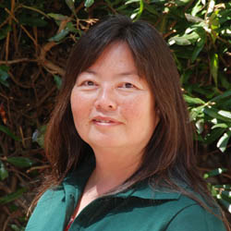
Suspect 1: Ms. Q
Ms. Q is the chemistry teacher. An avid believer in vampires, Ms. Q carries salt with her wherever she goes.
Pen found in her backpack: Zebra Zgrip

Slide 6
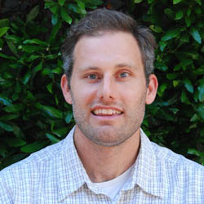
Suspect 2: Mr. Clederman
Mr. Clederman is the integrated science instructor. He is coffee addict and always has instant coffee and packets of sugar with him.
Pen found in his backpack: Bic Round Stic Grip

Slide 7
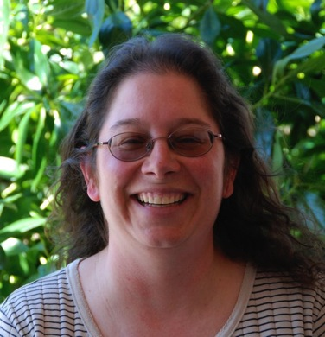
Suspect 3: Ms. Minandro
Ms. Minandro is the marine biology teacher. She is known for her “old school’ teaching style, still using chalkboards in the classroom.
Pen found in her purse: Office Max Ballpoint

Slide 8
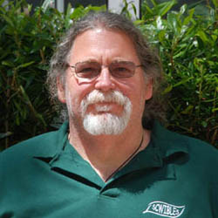
Suspect 4: Mr. Fallaclan
Mr. Fallaclan is a chemistry teacher. He loves seafood and eats it every day for lunch. To be sure his seafood isn’t bland, he always carries salt with him.
Pen found in his laptop bag: Office Max Ballpoint

Slide 9
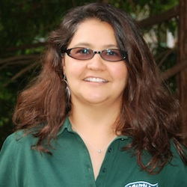
Suspect 5: Mrs. Jerradora
Ms. Jerradora is an engineering and chemistry teacher. She is an avid gardener, often going straight from school to one of her garden plots. She was found with some orchid fertilizer in her bag.
Pen found in her purse: Papermate ballpoint Flex Grip elite

Slide 10
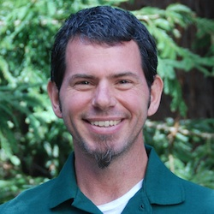
Suspect 6: Mr. Jostone
Mr. Jostone is a high school biology teacher. Before he became a teacher, he worked at a hospital. Due to his medical expertise, many teachers come to him for health advice. They say that he uses boric acid for an antiseptic!
Pen found in his wallet: Papermate Gel

Slide 11
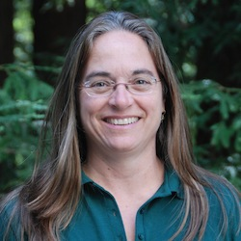
Suspect 7: Ms. Gardener
Ms. Gardener is a high school anatomy and physiology teacher. She recently conducted a health lab where students were given pure sugar to eat before testing their blood sugar.
Pen found in her car: Papermate ballpoint Flex Grip Elite

Slide 12
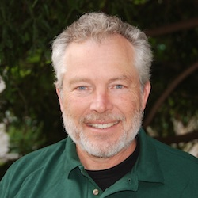
Suspect 8: Mr. Zuckter
Mr. Zuckter is a physics teacher. He has an ant problem in his classroom and has been using boric acid (a known insecticide) to get rid of the them.
Pen found in his teaching bag: Zebra Zgrip

Slide 13
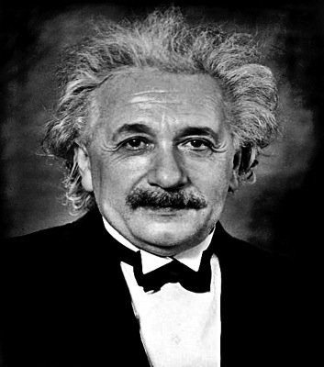
Suspect 9: Dr. Feinstein
Dr. Feinstein (known as “Mad Dr. Feinstein”) is the lead scientist at the Driscoll Berry Laboratory in Watsonville. He always carries fertilizer from the berry field with with him. Dr. Feinstein has been known to gamble on the berry crop and may have stolen the balances to pay off his debts.
Pen found at the lab: Bic Round Stic Grip

Slide 14
Chemistry forensics skills
You will need to test for:
Melting point
Solubility
Conductivity
Flame color
Ink test – chromatography

Slide 15
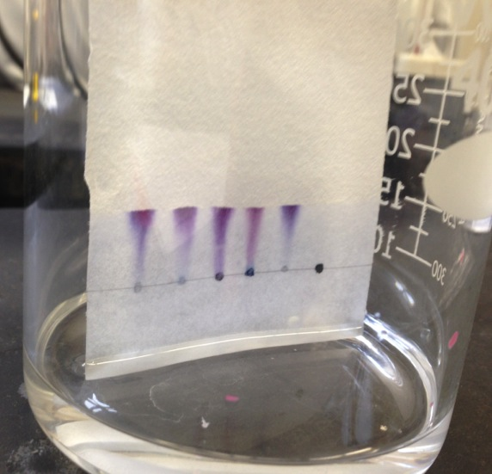
Chromatography
Pour 25 ml of alcohol into a 400 ml beaker.
Prepare chromatography paper using the 5 pens from the crime suspects.
Place the samples in the beaker to develop and wait 20 minutes.
Compare the ink sample from the crime scene to the ink samples from the suspect’s pens.

Slide 16
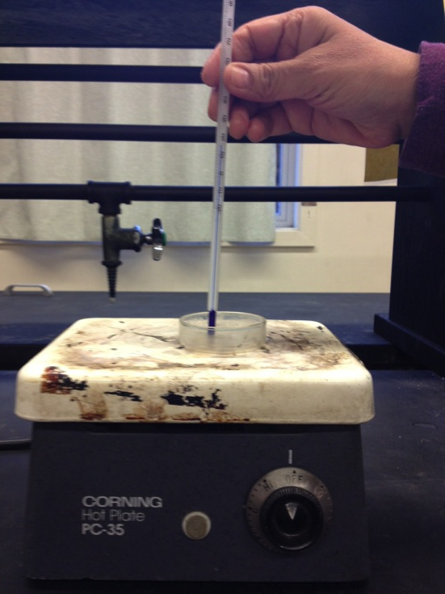
Melting point test
Plug in the hot plate.
Put a sample of the unknown on a slide.
Place the slide on the hot plate.
Record the melting point if the compound melts.

Slide 17
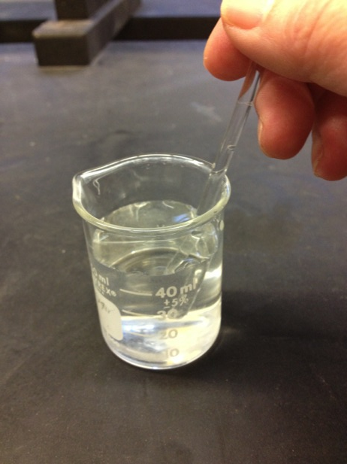
Solubility test
Make a solution with 5 mL water and 2 scoops of the solid.
Stir the solution.
Does the solid dissolve, settle to the bottom or coat the top? Record this information.

Slide 18
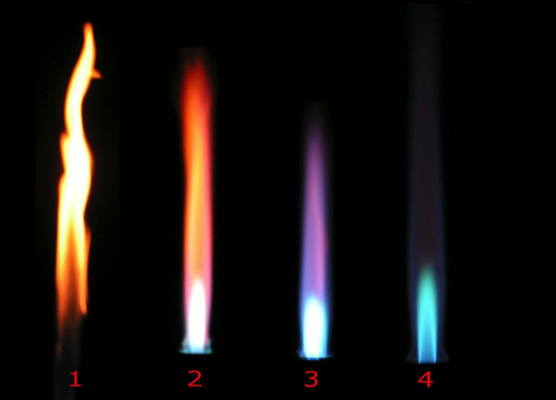
Flame test
Some chemicals have distinct colors when being burned.

Slide 19
Flame test
Use your concentrated solution.
Safely light your Bunsen burner (practice creating sparks before turning on gas!).
Dip a damp wooden stick into the unknown solid and place it over the flame.
Record the color of the flame.

Slide 20
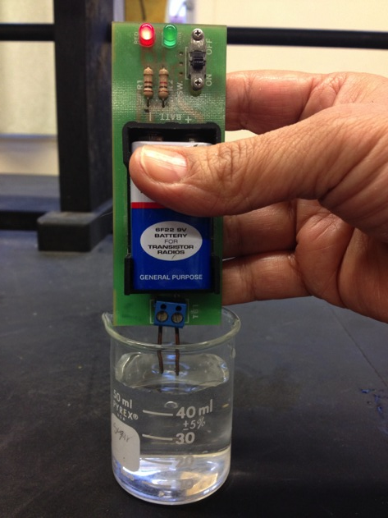
Conductivity test
Again, use the concentrated solution.
Submerge the copper wires of the conductivity meter.
Record whether the solution conducts electricity.

Slide 21
Chemical Reference Sheet

Slide 22
Instructions
Break into lab groups
Get evidence packet from front of room
Fill out Evidence Log and Work Plan
Work plan must be approved!
Test evidence to solve the crime
Clean up lab tables and equipment
Write crime lab report

Slide 23
Safety Tips
Wear lab coats
Wear safety glasses
Tie back long hair
Keep alcohol (chromatography) FAR AWAY from flames

